Slide 1

IT-4259: Computer Network Security
for
4th Year 2nd Semester of B.Sc (Honors) in IT (5th Batch)
Lecture: 04
Cryptography-A Security Mechanism-2
Prepared by:
K M Akkas Ali
akkas_khan@yahoo.com, akkas@juniv.edu
Associate Professor
Institute of Information Technology (IIT)
Jahangirnagar University, Dhaka-1342

Slide 2
Lecture-04: Cryptography- A Security Mechanism-2
Objectives of this Lecture:
  To illustrate some transposition ciphers:
  Keyless cipher
  Keyed cipher
  Columnar cipher
  To differentiate between traditional and modern symmetric-key ciphers.
  To illustrate DES as a modern symmetric-key cipher.
  To illustrate RSA as a modern asymmetric-key cipher.
5.<number>

Slide 3
Transposition Ciphers
What is Transposition Ciphers
A transposition cipher does not substitute one symbol for another, instead it changes the location of the symbols.
A symbol in the first position of the plaintext may appear in the ninth position of the ciphertext. A symbol in the eighth position of the plaintext may appear in the first position of the ciphertext.
Types of Transposition Ciphers
There are three types of transposition cipher:
Keyless Transposition Ciphers
Keyed Transposition Ciphers
- Keyed Columnar Transposition Ciphers or Columnar Transposition Ciphers
5.<number>

Slide 4
Keyless Transposition Ciphers
These are simple transposition ciphers and were used in the past.
There are two methods for permutation of characters:
  In the first method, the text is written into a table column by column and then transmitted row by row.
  In the second method, the text is written into a table row by row and then transmitted column by column.
5.<number>

Slide 5
Keyless Transposition Ciphers
Example:
1st Method: Written column by column and transmitted row by row
A good example of a keyless cipher using the first method is the rail fence cipher.
In this cipher, the plaintext is arranged in two lines as a zigzag pattern (which means column by column).
  The ciphertext is created reading the pattern row by row. For example, to send the message “Meet me at the park” to Bob, Alice writes-
By sending the first row followed by the second row, Alice then creates the ciphertext “MEMATEAKETETHPR”.
Bob receives the ciphertext and divides in half (in this example, the second half has one less character). The first half forms the first row; the second half forms the second row. She reads the result in zigzag.
Because there is no key and the number of rows is fixed (2 here), the cryptanalysis of the ciphertext would be very easy for Eve.
5.<number>

Slide 6
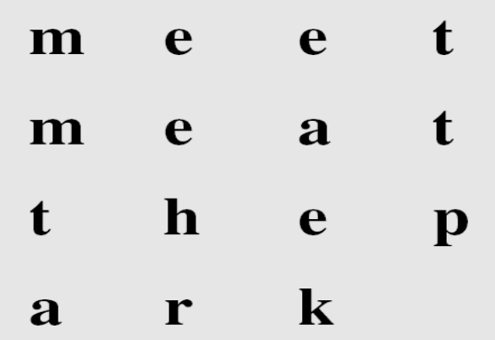
Keyless Transposition Ciphers
Example:
2nd Method: Written row by row and transmitted column by column
  Alice and Bob can agree on the number of columns and use the second method. Alice writes the same plaintext, row by row, in a table of four columns.
By transmitting the characters column by column, Alice then creates the ciphertext “MMTAEEHREAEKTTP”.
Bob receives the ciphertext and follows the reverse process. He writes the received message column by column and reads it row by row as the plaintext.
Eve can easily decipher the message if she knows the number of columns.
5.<number>

Slide 7
Keyless Transposition Ciphers
Example:
The cipher in the previous example is actually a transposition cipher. The following shows the permutation of each character in the plaintext into the ciphertext based on the positions.
Plaintext | : | m | e | e | t | m | e | a | t | t | h | e | p | a | r | K
Source Position | : | 01 | 02 | 03 | 04 | 05 | 06 | 07 | 08 | 09 | 10 | 11 | 12 | 13 | 14 | 15
 |  |  |  |  |  |  |  |  |  |  |  |  |  |  |  | 
Destination Position | : | 01 | 05 | 09 | 13 | 02 | 06 | 10 | 14 | 03 | 07 | 11 | 15 | 04 | 08 | 12
Ciphertext | : | M | M | T | A | E | E | H | R | E | A | E | K | T | T | P
The first character in the plaintext has not changed its position. The second character in the plaintext has moved to the fifth position in the ciphertext; the third character has moved to the ninth position; and so on.
Although the characters are permuted, there is a pattern in the permutation: (01, 05, 09, 13), (02, 06, 10, 14), (03, 07, 11, 15), and (04, 08, 12). In each section, the difference between the two adjacent numbers is 4.
5.<number>

Slide 8
Keyed Transposition Ciphers
The keyless ciphers permute the characters by using writing plaintext in one way (e.g. row by row) and reading it in another way (e.g. column by column). The permutation is done on the whole plaintext to create the whole ciphertext.
In keyed transposition cipher, the plaintext is divided into groups of predetermined size, called blocks, and then use a key to permute the characters in each block separately.
5.<number>

Slide 9
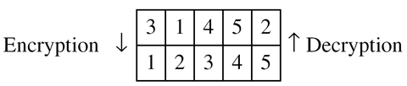
Keyed Transposition Ciphers
Example:
Alice needs to send the message “Enemy attacks tonight” to Bob.
They have agreed to divide the text into groups of five characters and then permute the characters in each group.
To make the last group the same size, a bogus character z is added at the end.
The key used for encryption and decryption is a permutation key, which shows how the character are permuted. For the above message, we assume that Alice and Bob used the following key:
The third character in the plaintext block becomes the first character in the ciphertext block.
Similarly, the first character in the plaintext block becomes
the second character in the ciphertext block , and so on.
The permutation yields:
Alice sends the ciphertext “EEMYNTAACTTKONSHITZG” to Bob. Bob divides the ciphertext into 5-character groups and finds the plaintext using the key in reverse order.
5.<number>

Slide 10
Columnar Transposition Ciphers
This type of transposition cipher combines the keyless and keyed transposition ciphers to achieve better scrambling.
Encryption or decryption is done in three steps:
    The text is written into a table row by row.
    The permutation is done by reordering the columns.
    The new table is read column by column.
Here, the 1st and 3rd steps provide a keyless global reordering and the 2nd step provides a blockwise keyed reordering.
5.<number>

Slide 11
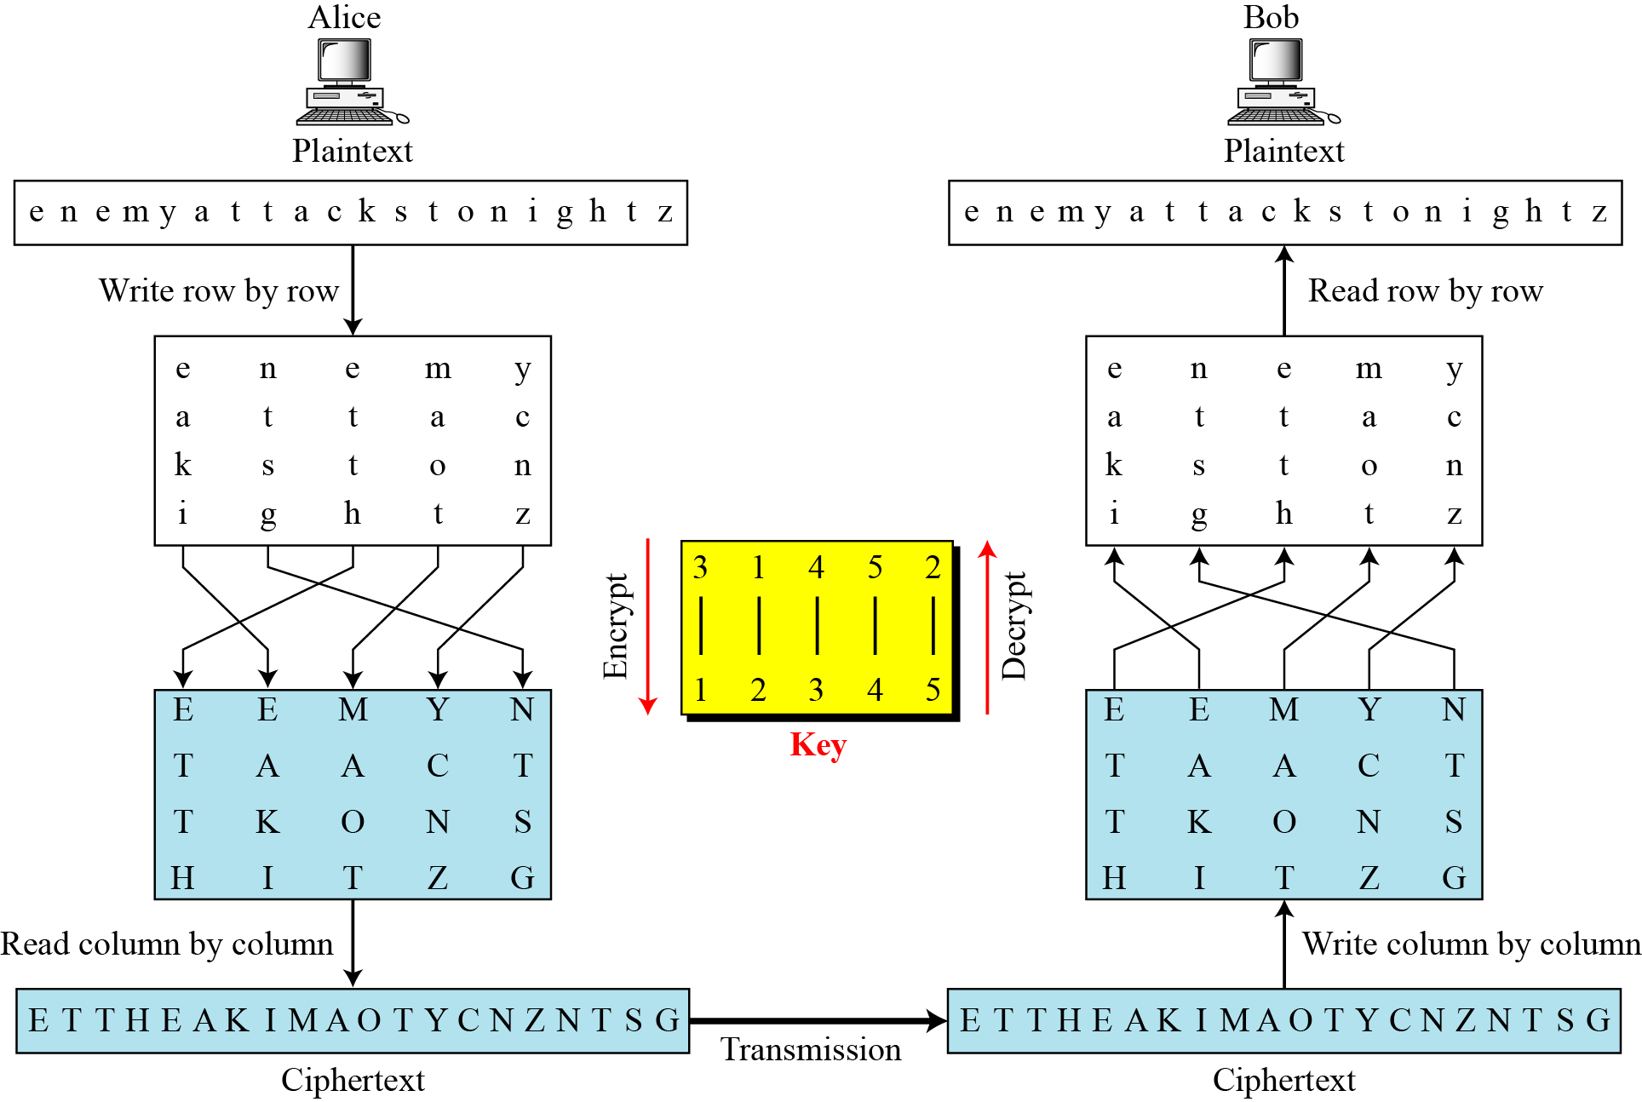
Columnar Transposition Ciphers
Example:
Encrypt the message “enemy attacks tonight” using Columnar transposition cipher.
Solution: The encryption and decryption is illustrated in the figure below.
The 1st table in the figure is created by Alice writing the plaintext row by row.
The columns are permuted using the key mentioned.
The ciphertext is created by reading the 2nd table column by column.
Bob does the same three steps in the reverse order.
5.<number>
Figure: Columnar transposition cipher

Slide 12
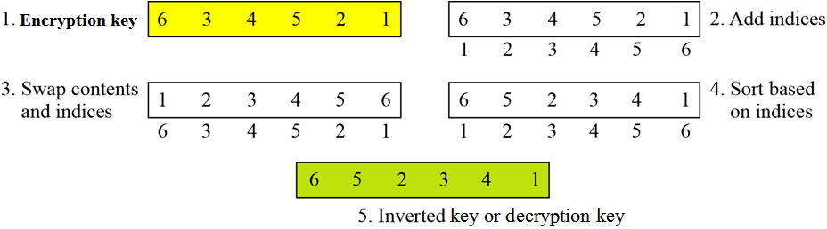
Key inversion in a transposition cipher
How can the inverse of a key be created if the initial or original key is given, or vice versa?
The process can be done manually in a few steps.
Figure below shows how to invert an encryption key, i.e. how to find the decryption key.
Figure: Inverting a permutation table
5.<number>

Slide 13
Traditional Vs. Modern Symmetric-key Ciphers:
The traditional symmetric-key ciphers were used in the past. They are character-oriented ciphers.
Traditional ciphers are simpler than modern ciphers and easier to understand. They can be easily attacked using a computer.
Two broad categories of traditional symmetric-key ciphers are:
Traditional substitution ciphers
Traditional transposition ciphers
Now-a-days, the information to be encrypted is not just text; it can also consist of numbers, graphics, audio, and video data. It is convenient to convert these types of data into a stream of bits, to encrypt the stream, and then to send the encrypted stream. So, we need bit-oriented ciphers.
When data is treated as the collection of bits, it becomes larger. Mixing a larger number of symbols increases security.
Two broad categories of modern symmetric-key ciphers are:
Modern stream ciphers
Modern block ciphers
5.<number>

Slide 14
Stream Ciphers:
Stream cipher encrypts a single character or bit of plaintext at a time. It also decrypts a single character or bit of ciphertext at a time.
Example:
Given plaintext: 10011011110100001
Let the keystream be a stream of 1s and 0s.
If we use an exclusive or (XOR) with the keystream and plaintext, we get ciphertext.
This keystream is called periodic, since the sequence '10' repeats over and over.
Plaintext : 10011011110100001
Keystream : 10101010101010101
Ciphertext : 00110001011110100 (by XORing each plaintext bit with corresponding keystream bit)
To decrypt this ciphertext, all we need to do is again XOR the ciphertext with the keystream:
Ciphertext : 00110001011110100
Keystream : 10101010101010101
Plaintext (XOR) : 10011011110100001
5.<number>

Slide 15
Block Ciphers:
A symmetric-key modern block cipher encrypts an
n-bit block of plaintext or decrypts an n-bit block of ciphertext together.
The decryption algorithm must be the inverse of the encryption algorithm.
If the message has the fewer than n bits, padding must be added to make it an n-bit block. If the message has more than n bits, it should be divided into n-bit blocks and the appropriate padding must be added to the last block if necessary.
The common values of n are 64, 128, 256, or 512 bits.
Figure: A modern block cipher
Example
Plaintext : The only thing we have to fear is fear itself
Modified plaintext : Theonlythingwehavetofearisfearitself
Plaintext blocks : Theonlyt hingweha vetofear isfearit selfXend (break the plaintext into 8-character block)
Ciphertext blocks : tylnoehT ahewgnih raefotev tiraefsi dneXfles (just reverse each plaintext block)
Ciphertext : tylnoehTahewgnihraefotevtiraefsidneXfles
5.<number>

Slide 16
Data Encryption Standard (DES)
The Data Encryption Standard (DES) is a symmetric-key block cipher designed by IBM and published by the National Institute of Standards and Technology (NIST).
It is a 64 bit block cipher with key length 56 bits.
In DES, the plaintext input bit string is divided into 64-bit blocks and each block is encrypted using the same 56-bit key. The same key is used for decryption.
It consists of a number of rounds where each round contains bit-shuffling, non-linear substitutions (S-boxes) and exclusive OR operations. These are done in order to increase the difficulty of performing a cryptanalysis on the cipher.
DES had been used as a standard method of encryption until 2000, but with increase in speed in computers, it is no more considered secure since a cryptanalyst can break the code by exhaustively searching for all the keys using a fast computer.
However, a modification of DES, called triple DES (or 3 DES), is now used which is more secure and is difficult to break.
After 25 years of analysis, the only security problem with DES found is that its key length is too short.
From 2001, DES has been replaced by a new standard known as the Advanced Encryption Standard (AES).
5.<number>

Slide 17
DES Algorithm/DES Structure:
In DES, plaintext message is broken into blocks of length 64 bits. Each 64-bit block of plaintext is encrypted using a 56-bit key.
A 56-bit key k is fed into a subkey generating algorithm to produce 16 round subkeys k₁, k₂, k₃, ……., k₁₆ of length 48 bits each.
At first, an initial permutation (IP) is performed on the 64-bit block of plaintext. (The initial permutation rearranges the bits of the plaintext to form the “permuted input” based on the IP table).
After initial permutation, the 64-bit permuted block is divided into two 32-bit sub-blocks represented by L₀ and R₀ as the left and right sub-block respectively.
The encryption then proceeds through 16 rounds of identical operations using a different sub-key of length 48-bit in each round on the left and right halves of the block.
The output found using key k_{i} after i_{th} round is represented by L_{i} and R_{i} respectively where i=1, 2, 3, …..,16. Round i has input L_{i-1}||R_{i-1} and output L_{i}||R_{i} where
L_{i}=R_{i-1}
R_{i}=L_{i-1}  f(R_{i-1},k_{i})
5.<number>

Slide 18
DES Algorithm/DES Structure (continued…):
In the final round, the left (L) and right (R) halves are swapped, so that the decryption algorithm has the same structure as the encryption algorithm.
After the final round (16th round), the right and left halves are joined or concatenated.
Then, a final permutation IP⁻¹ (which is the inverse of the initial permutation), is applied to the 64-bit joining block. The output of this final permutation is the 64 bit encrypted output (ciphertext).
Figure on the next slide illustrates how the algorithm works.
Decryption is identical to encryption, except that the subkeys are used in the opposite order. That is, subkey 16 is used in round 1, subkey 15 is used in round 2, etc., ending with subkey 1 being used in round 16.
Each 64-bit block of plaintext is encrypted using a 56-bit key.
5.<number>

Slide 19
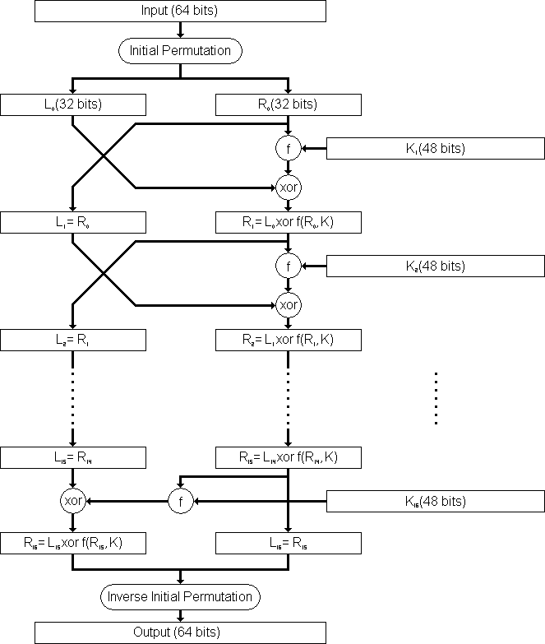
DES Algorithm/DES Structure (continued…):
Figure: Flow Diagram of DES algorithm for encrypting data.
5.<number>

Slide 20
DES Round Structure /DES Round Function f(R_{i-1},K_{i}):
In DES, substitution and permutation are used a number of times in iterations called rounds. Generally, the more rounds there are, the more secure the algorithm is.
The heart of DES is DES round function which mixes the bits of the right (R) portion using the subkey for the current round.
It applies a 48-bit key to the rightmost 32 bits (R_{i-1}) to produce a 32-bit output.
The round function is made up of four sections:
1. An expansion P-box (E-box)
2. A whitener (Exclusive-or that adds key)
3. A group of S-boxes (for 48 bit to 32 bit conversion)
A straight permutation P-box
5.<number>

Slide 21

DES Round Function f(R_{i-1},K_{i}):
1. The E-box expansion permutation:
Since R_{i−1} is a 32-bit input and K_{i} is a 48-bit key, we first need to expand R_{i−1} to 48 bits.
So, the 32-bit R value is expanded to 48 bits using an expansion P-box permutation table which is necessary for combination with the 48 bit subkey.
Figure: Expansion permutation
2. Whitener (Exclusive-or):
Expanded R value found from section-1 is then exclusive-or'ed with the 48-bit subkey.
7.<number>

Slide 22

DES Round Function f(R_{i-1},K_{i}):
3. The S-box substitution: 48 bits to 32 bits
The S-boxes do the real mixing (confusion). DES uses 8 S-boxes, each with a 6-bit input and a 4-bit output.
This is a highly important substitution which accepts a 48-bit input and outputs a 32-bit number.
The resulting 48 bits found from section-2 are divided into eight 6-bit chunks, each of which is fed into an S-Box that mixes the bits and produces a 4-bit output. Those 4-bit outputs are combined into a 32-bit value.
Figure: S-boxes
4. Straight Permutation (P-box):
The combined 32 bits found from section-3 are permuted once again to produce the 32 bits output of the round function using expansion P-box table.
7.<number>

Slide 23
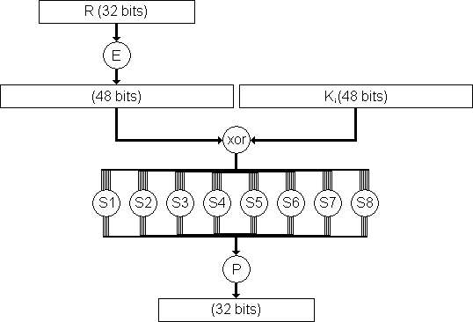
DES Round Function f(R_{i-1},K_{i}):
Figure below shows the DES round function f(Ri-1,Ki).
Figure: The round function f(R_{i-1},K_{i}) of the DES algorithm.
Note:
The s-boxes provide the “confusion” of data and key values, whilst the permutation P then spreads this as widely as possible, so each S-box output affects as many S-box inputs in the next round as possible, giving “diffusion”.
7.<number>

Slide 24
RSA Cryptosystem
  RSA is the most commonly used public-key cryptography algorithm, which uses prime factorization as the trapdoor one-way function.
  It is named so after the surnames of its inventors Ron Rivest, Adi Shamir, and Leonard Adleman of the Massachusetts Institute of Technology (MIT).
  It was first published in 1978.
  This algorithm relies on one way function. A one way function is easy to compute but hard to invert. For example it is easy to take the product of two prime numbers but given the product it is difficult to split it into the original prime factors.
  This algorithm lets you choose the size of your public key.
  The 512-bit keys are considered insecure or weak, but the 768-bit keys are secure from everything but the National Security Administration (NSA).
  The 1024-bit keys are secure from everything virtually.
  RSA is embedded in major products such as Windows, Netscape Navigator etc.
  It is used in digital signature and other cryptosystems that often need to encrypt a small message without having access to a symmetric key. RSA is also used for authentication
  Although RSA can be used to encrypt and decrypt actual messages, it is very slow if the message is long. Therefore, RSA is useful for short messages.
7.24

Slide 25
Steps in RSA Algorithm
  The RSA algorithm involves three steps:
  Key generation (Generating public and private key)
  Encryption (Encrypting the message)
  Decryption (Decrypting the message)
  RSA involves a public key and a private key.
  The public key can be known by everyone and is used for encrypting messages.
  Messages encrypted with the public key can only be decrypted in a reasonable amount of time using the private key.
7.25

Slide 26
RSA Algorithm: Key Generation
  The keys for the RSA algorithm are generated by the following ways:
Choose two large and distinct prime numbers p and q.
  For security purposes, the integers p and q should be chosen at random, and should be of similar bit-length.
  In RSA, p and q must be at least 512 bits; n must be at least 1024 bits.
  Prime integers can be efficiently found using a primality test.
Compute n = p * q
  n is used as the modulus for both the public and private keys. Its length, usually expressed in bits, is the key length.
Compute the number of integers less than n that are coprime with n (otherwise known as the totient or Euler’s Phi function):
  φ(n) = φ(p*q) = φ(p)* φ(q)=(p - 1) * (q – 1)
Choose an integer e such that 1 < e < φ(n) and gcd(e, φ(n)) = 1; i.e. e and φ(n) are coprime.
  e is released as the public key exponent (encryption exponent).
  e having a short bit-length results in more efficient encryption– most commonly 2¹⁶ + 1 = 65,537. However, much smaller values of e (such as 3) have been shown to be less secure in some settings.
7.26

Slide 27
RSA Algorithm: Key Generation
  Determine the multiplicative inverse d of e; i.e., compute a value for d such that it satisfies the relation: (d * e) mod φ(n) = 1
  d is kept as the private key exponent (decryption exponent).
  d is often computed using the extended Euclidean algorithm.
  d must be kept secret.
  p, q, and φ(n) must also be kept secret because they can be used to calculate d.
The public key consists of the modulus n and the public key exponent e; i.e., the public key is (e, n).
The private key consists of the modulus n and the private key exponent d; i.e., the private key is (d, n).
To encrypt message m using the public key, use the relation:
c = m^{e} mod n
To decrypt c using the private key, use the relation:
m = c^{d} mod n
7.27

Slide 28
RSA Algorithm: Encryption
  Bob transmits his public key (e, n) to Alice and keeps the private key (d, n) secret.
  Alice then wishes to send message M to Bob.
  The message is encrypted by the following ways:
  Alice first turns message M into an integer m, such that 0 ≤ m < n.
  That is, the message is represented as an integer between 0 and (n-1).
  Large messages can be broken up into a number of blocks. Each block would then be represented by an integer in the same range.
  After turning the message into integer, Alice then computes the ciphertext c using the following relation:
  c = m^{e} mod n
  After computing ciphertext, Alice then transmits c to Bob.
7.28

Slide 29
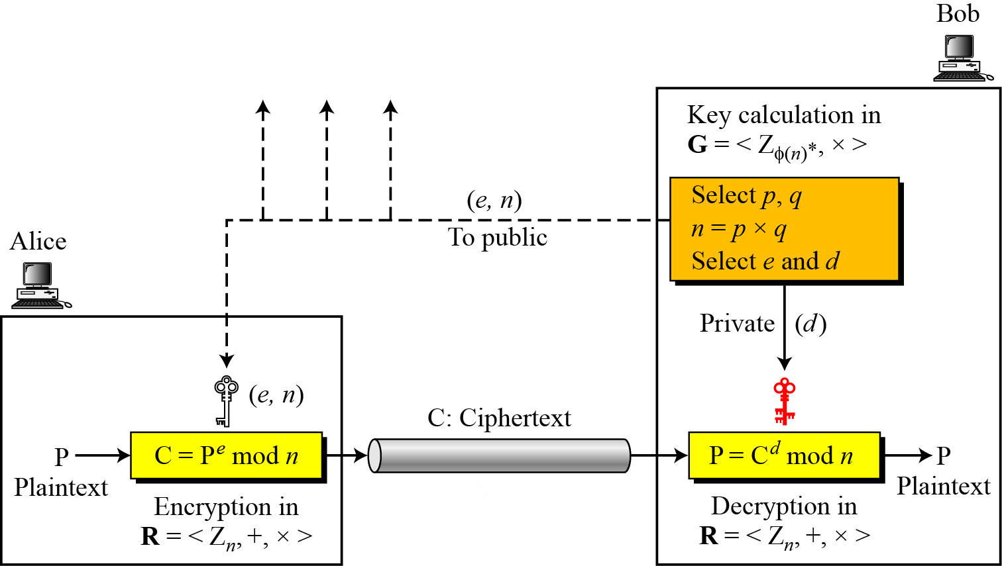
RSA Algorithm: Decryption
  Bob can recover m from c by using his private key exponent d using the following relation:
  m = c^{d} mod n
  After having m, Bob can recover the original message M by reversing the padding scheme.
  The encryption, decryption and key generation in RSA
  is shown in the figure below.
7.29
Figure: Encryption, decryption, and key generation in RSA

Slide 30
RSA Cryptosystem: Trivial Examples
  Choose p = 3 and q = 11
  Compute n = p * q = 3 * 11 = 33
  Compute φ(n) = φ(p*q) = φ(p)* φ(q)=(p - 1) * (q - 1) = 2 * 10 = 20
  Choose e such that 1 < e < φ(n) and e and φ(n) are coprime. We have several choices for e: 7, 11, 13, 17, 19. (We cannot use 5 as e, because 20 is divisible by 5). Let e = 7
  Compute a value for d such that (d * e) mod φ(n) = 1. One solution is d = 3 [(3 * 7) % 20 = 1] [d is the multiplicative inverse of e]
  Public key is (e, n) => (7, 33)
  Private key is (d, n) => (3, 33)
  The encryption of m = 2 is c = m^{e} mod n = 2⁷ mod 33 = 29
  The decryption of c = 29 is m = c^{d} mod n = 29³ mod 33 = 2
7.30

